Slide 1



Slide 2
Fast and Curious

Slide 3

OUTLINE
Product Roadmap
Innovation
Disruptive Innovation
Market Strategy
Value Creation
Stickiness
Revenue
Critical Appreciation
References
SEE WHAT’S NEXT

Slide 4
PRODUCT ROADMAP
1997-1999
2000-2006
2007-2010
Focuses on growing streaming through partnerships and devices
Begins international expansion by launching in Canada in 2010
Technology Innovation: Streaming apps across devices
Revenue: $2.2B
Partnerships: Device manufacturers like LG, Sony, Microsoft
Launched DVD rental by mail
Introduces monthly subscription model in 1998
Technology Innovation: Online DVD rental model
Revenue: $5M
Partnerships: None
Goes public via IPO in 2002
Reaches 1 million subscribers in 2003
Technology Innovation: Online streaming
Revenue: $997M
Partnerships: Movie studio content licensing deals

Slide 5
PRODUCT ROADMAP
2011-2014
2015-2018
2019-2023
Invested heavily in original content, launched House of Cards in 2013
Expands streaming to Latin America, UK, and Europe
Technology Innovation: Online-only original content
Revenue: $5.5B
Partnerships: ISPs like Comcast and Verizon for faster streaming
Completes massive tech migration to cloud with Amazon Web Services
Reaches near global availability, expanding to 130 new countries
Technology Innovation: Shift to cloud infrastructure
Revenue: $15.8B
Partnerships: Mobile carriers for billing and bundled plans
Focuses on retention as competition increases
Expanded into interactive content and mobile gaming
Technology Innovation: Mobile games, personalized recommendations
Revenue: $31.6B
Partnerships: Consumer brands like Walmart, Pepsi, Domino's for promotions

Slide 6








INNOVATION
4
The Netflix Queue
Unlimited access with ease
Binge Watching
Personalized Recommendation algorithm
Video Streaming
Subscription Model
Exclusive Content And Original Programming
Global Reach
Play
+

Slide 7
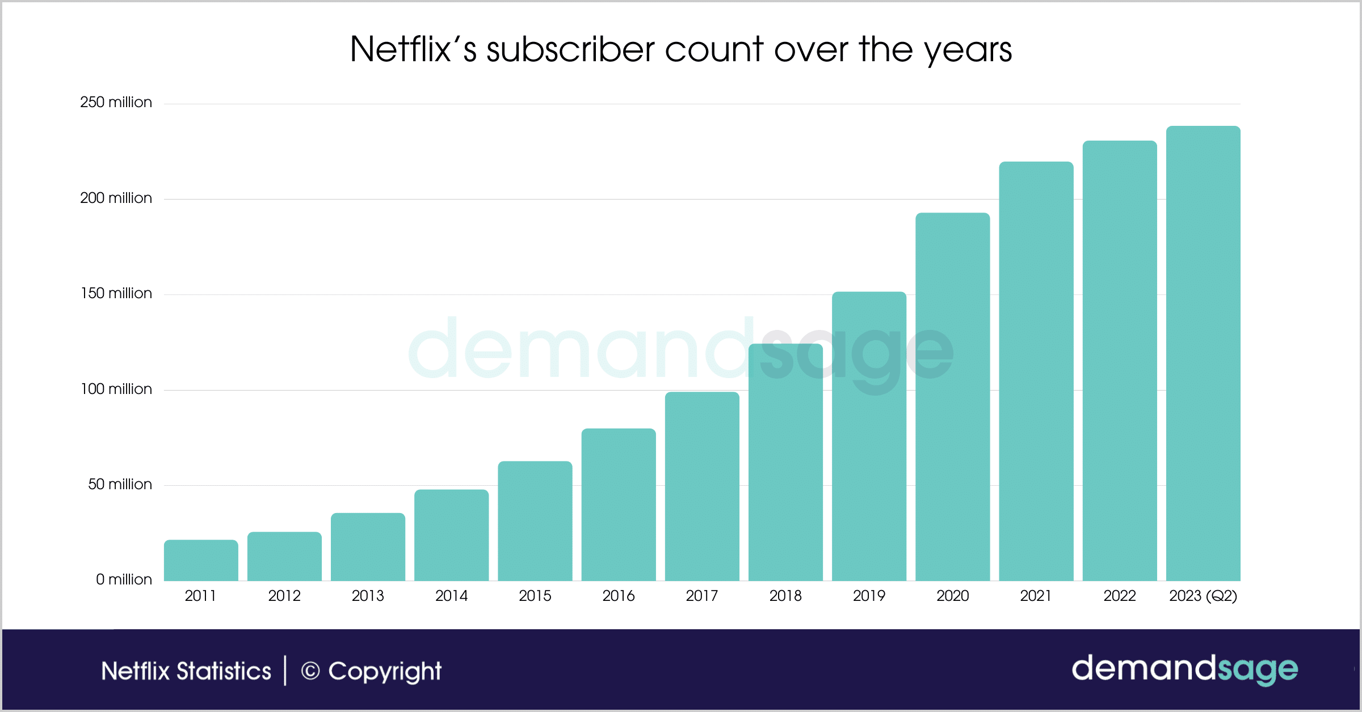
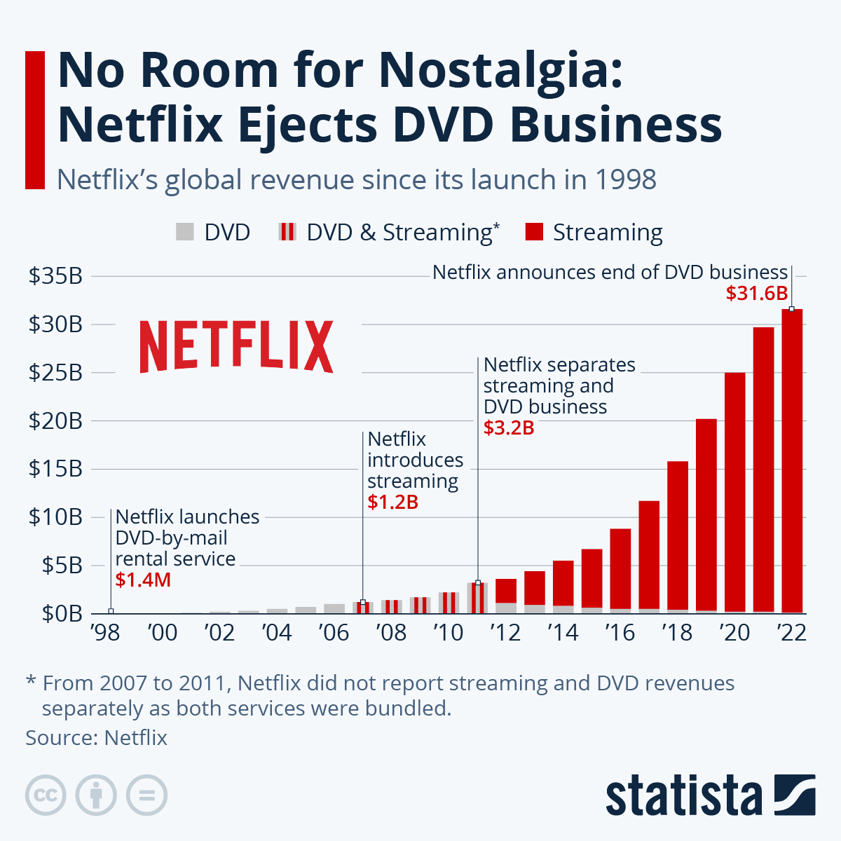
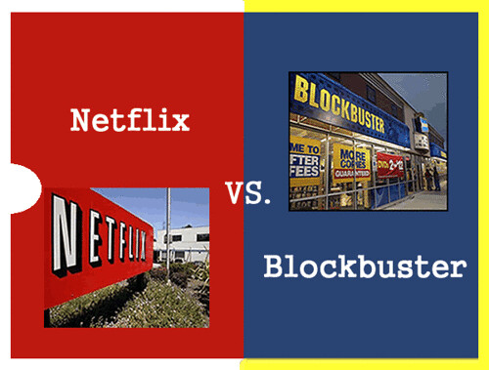

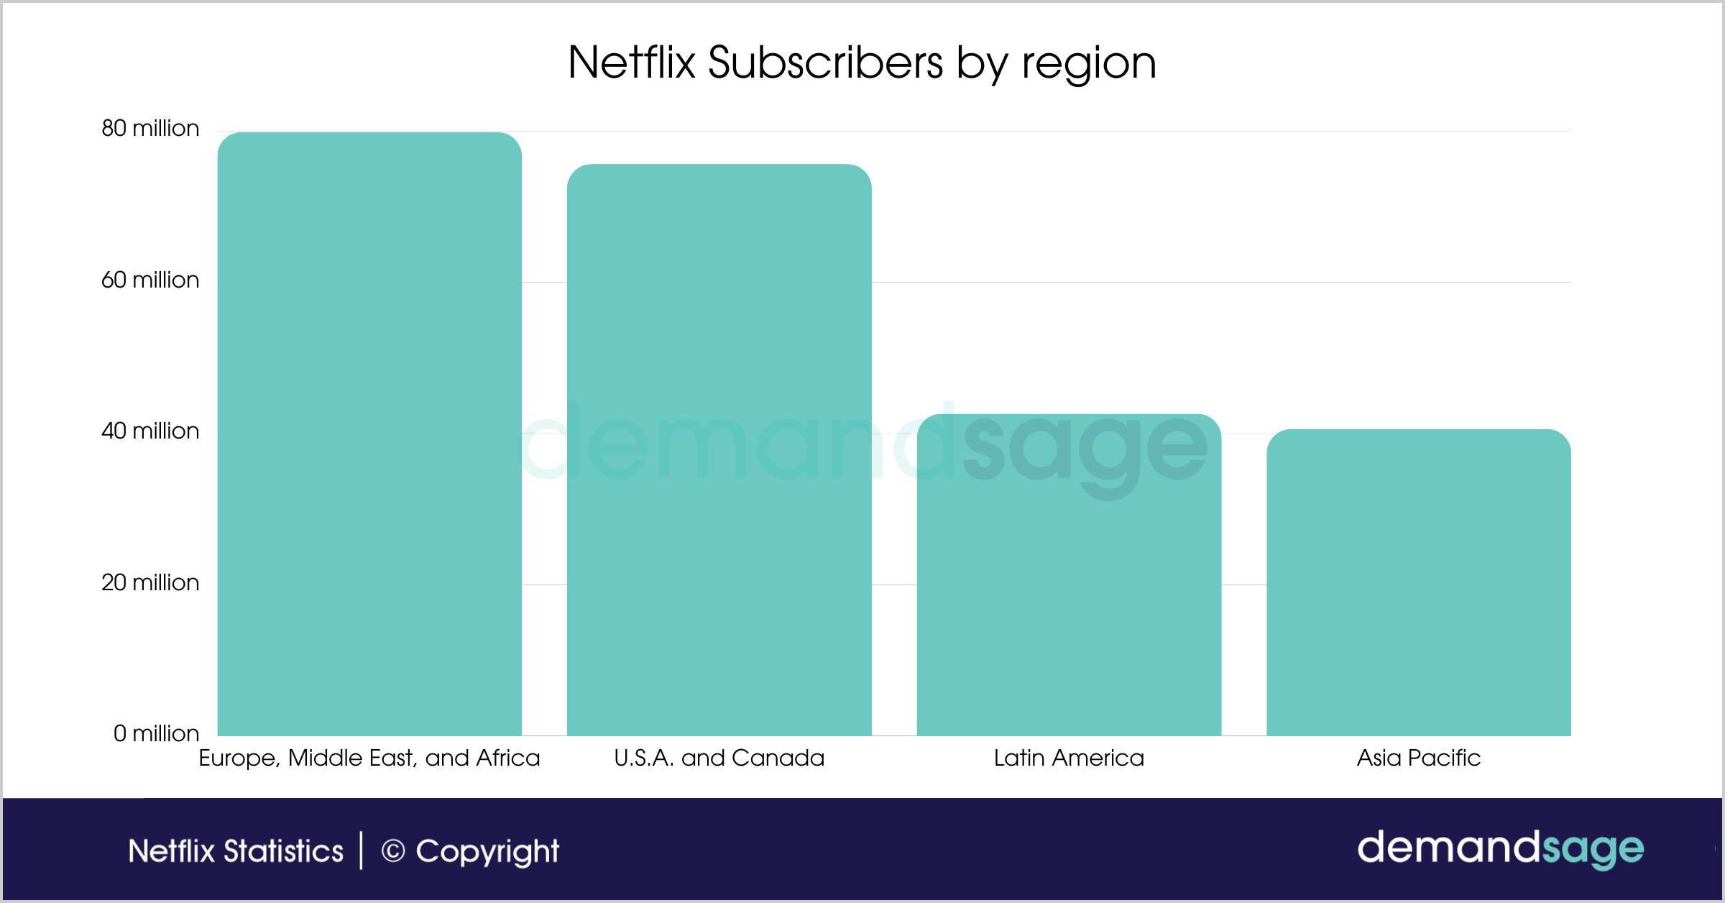
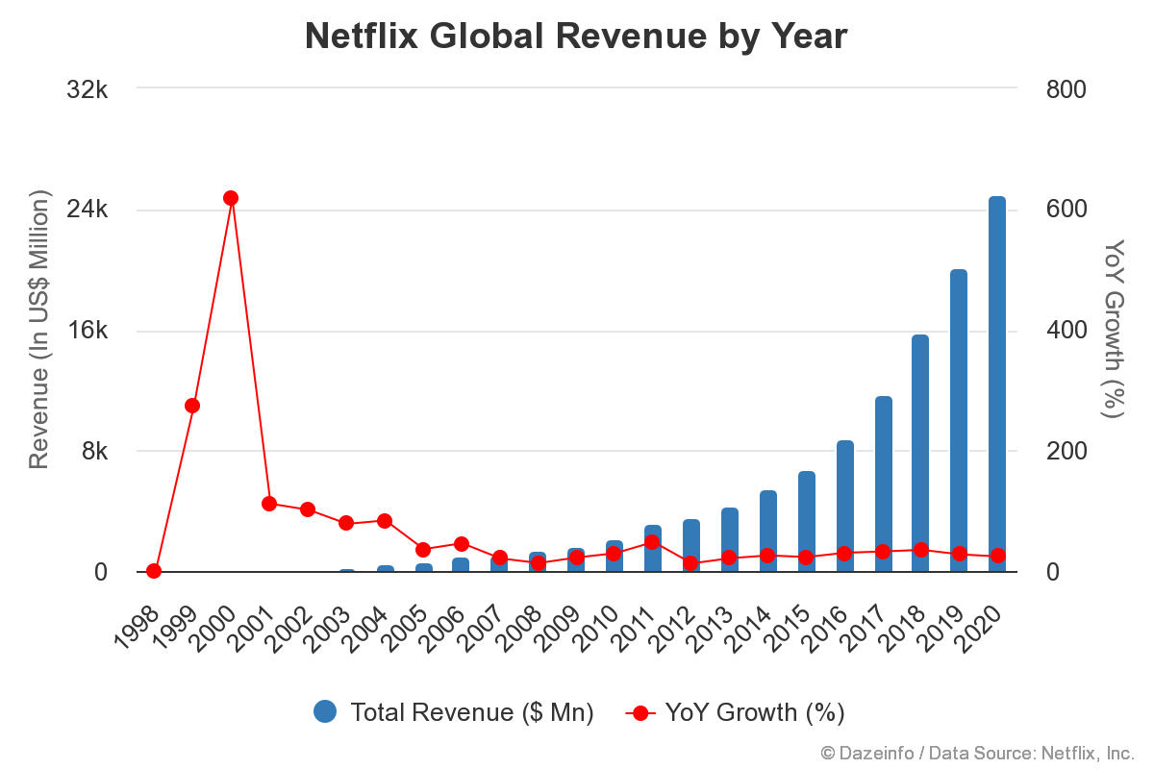
DISRUPTIVE INNOVATION
4
DVD-by-mail service:
In late 1990s, Netflix launched this service to let people rent videos they select online then send out the DVD’s by mail to the customer doorstep
Online streaming:
In 2007, shifting their customers to streaming subscribers and was quitting the DVD rental business
Content Production:
In 2013, Netflix started to develop their own production and shows. It won three Emmy awards, and its U.S. subscriber base grew to nearly 29 million in 2013.
Global expansion:
By 2017, Netflix scaled significantly internationally in over 190 countries with more than half of its some 130 million subscribers were outside the U.S.
Play
+
Notes:
In late 1990s, to let people rent videos they select online then send out the DVD’s by mail to the customer doorstep, without charging the customers fees for late returns
https://dazeinfo.com/2019/07/14/netflix-annual-revenue-worldwide-graphfarm/
https://www.demandsage.com/netflix-subscribers/

Slide 8
VALUE CREATION
4
USERS
CREATORS
INDUSTRY
EMPLOYEES
Entertainment – Netflix has over 17,000 titles
Best User Interface
238.39 million paid subscribers
Multiple subscription models like mobile, single device, family plan
Multiple language options
Variable Streaming device options – iPad, TV, mobile
Download & Watch offline
Around 80% of Netflix users take the streaming service’s title recommendations offered by its algorithm
Netflix’s original content - Netflix has produced over 1,500 original titles since it began producing original content in 2013
Investment in good content - In 2017, Netflix won its first Oscar.
In 2022, Netflix lead the pack with 27 Oscar nominations.
Netflix has received over 800 nominations and over 250 awards for its original content
Boost to the entertainment industry especially during pandemic time
Local artists are getting a platform to showcase their talent as Netflix has shows in over 60 languages
More global engagement – present in over 190 countries
Stock Option Program- Netflix employees get to choose what % of salary they want in the form of stocks
Personal Top of the Market- Best salaries in the market
Employee Giving Program – Netflix matches the amount, its employee contributes towards donations and social welfare
Unlimited Time away – no 9-5 job
Play
+

Slide 9
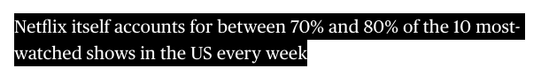
STICKINESS
4
Original Content​
Personalization and Recommendation Algorithm​
Continuous Content Updates​
User-Friendly Interface
Accessibility
Netflix Games
Play
+

Slide 10
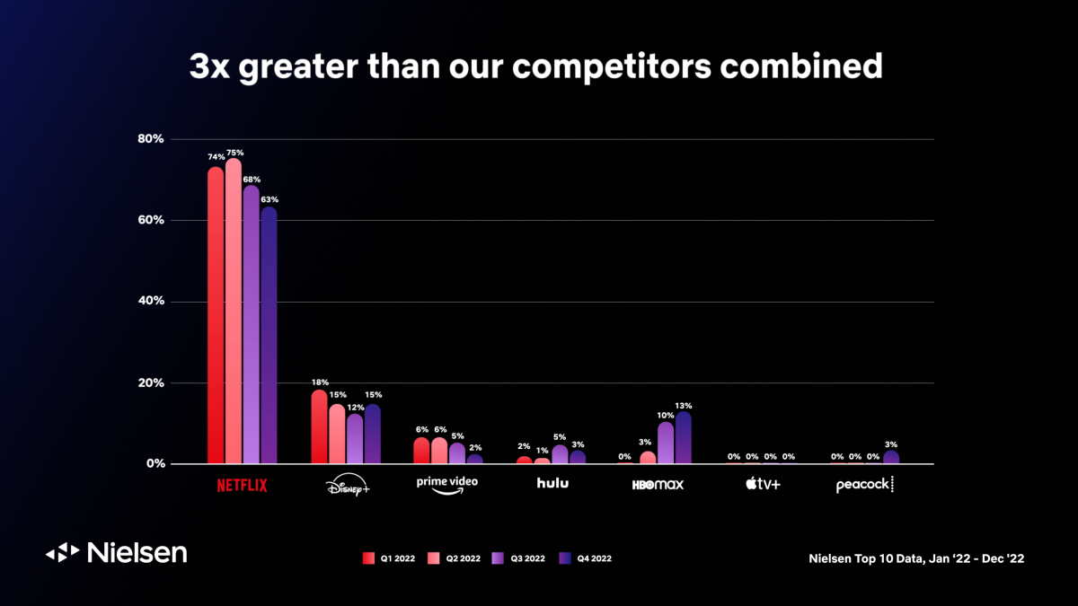
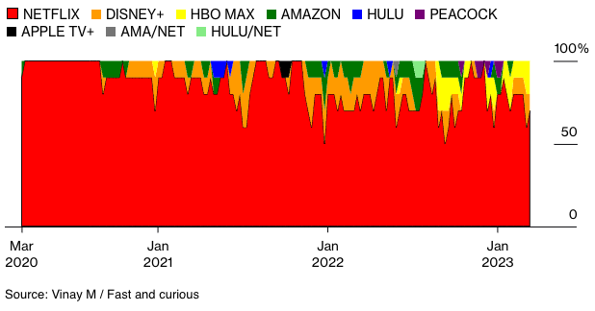
STICKINESS
4
Play
+

Slide 11
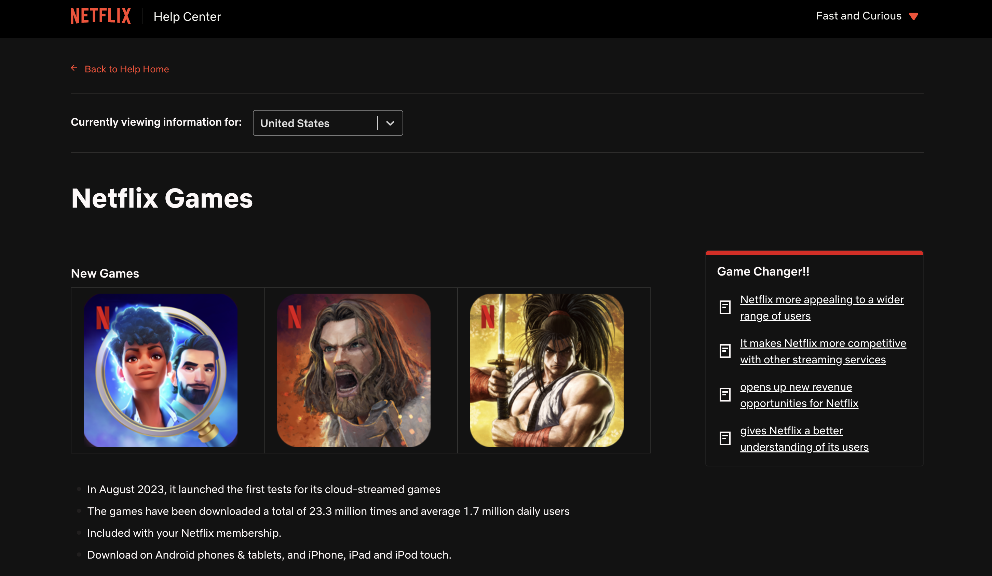
STICKINESS
4
Play
+

Slide 12
MARKET TYPES
4
EXISTING MARKET
NEW MARKET
EXPONENTIAL GROWTH
ADJACENT MARKET
Started as a DVD rental mailing service in 1997
No Late fees on DVD rentals.
Disrupted the traditional video rental industry.
Netflix pivoted towards content streaming by launching its video-on-demand service.
Netflix entered a new market for original content creation
High-quality personalized content
Disrupted the video streaming industry
US market saturation – preferred by 47% of Americans over other streaming platforms.​
Targeted English-speaking countries starting with international expansion in 2010 to Canada.​
Ventured into non-English-speaking countries across Europe, Latin America, and Asia.​
Seamless localization – subscriber base widened by 50% in 2 years.​
Reached 190+ countries by 2016.​
Achieved global growth and became one of the most popular streaming services in the world.​
Interactive Shows like Black Mirror - Bandersnatch
Netflix Games
Netflix Merchandise
POSITIONING
238.39 million subscribers
More subscribers than all other pure streaming services combined.
8% of all video viewing time globally
15% of global internet traffic use
Play
+

Slide 13
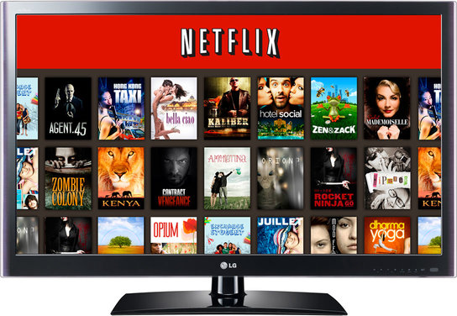


MARKETING STRATEGY
4
CONTENT VARIATION
RESONATE WITH LOCAL CULTURE
Don’t Promote,
ENTERTAIN !
Play
+

Slide 14
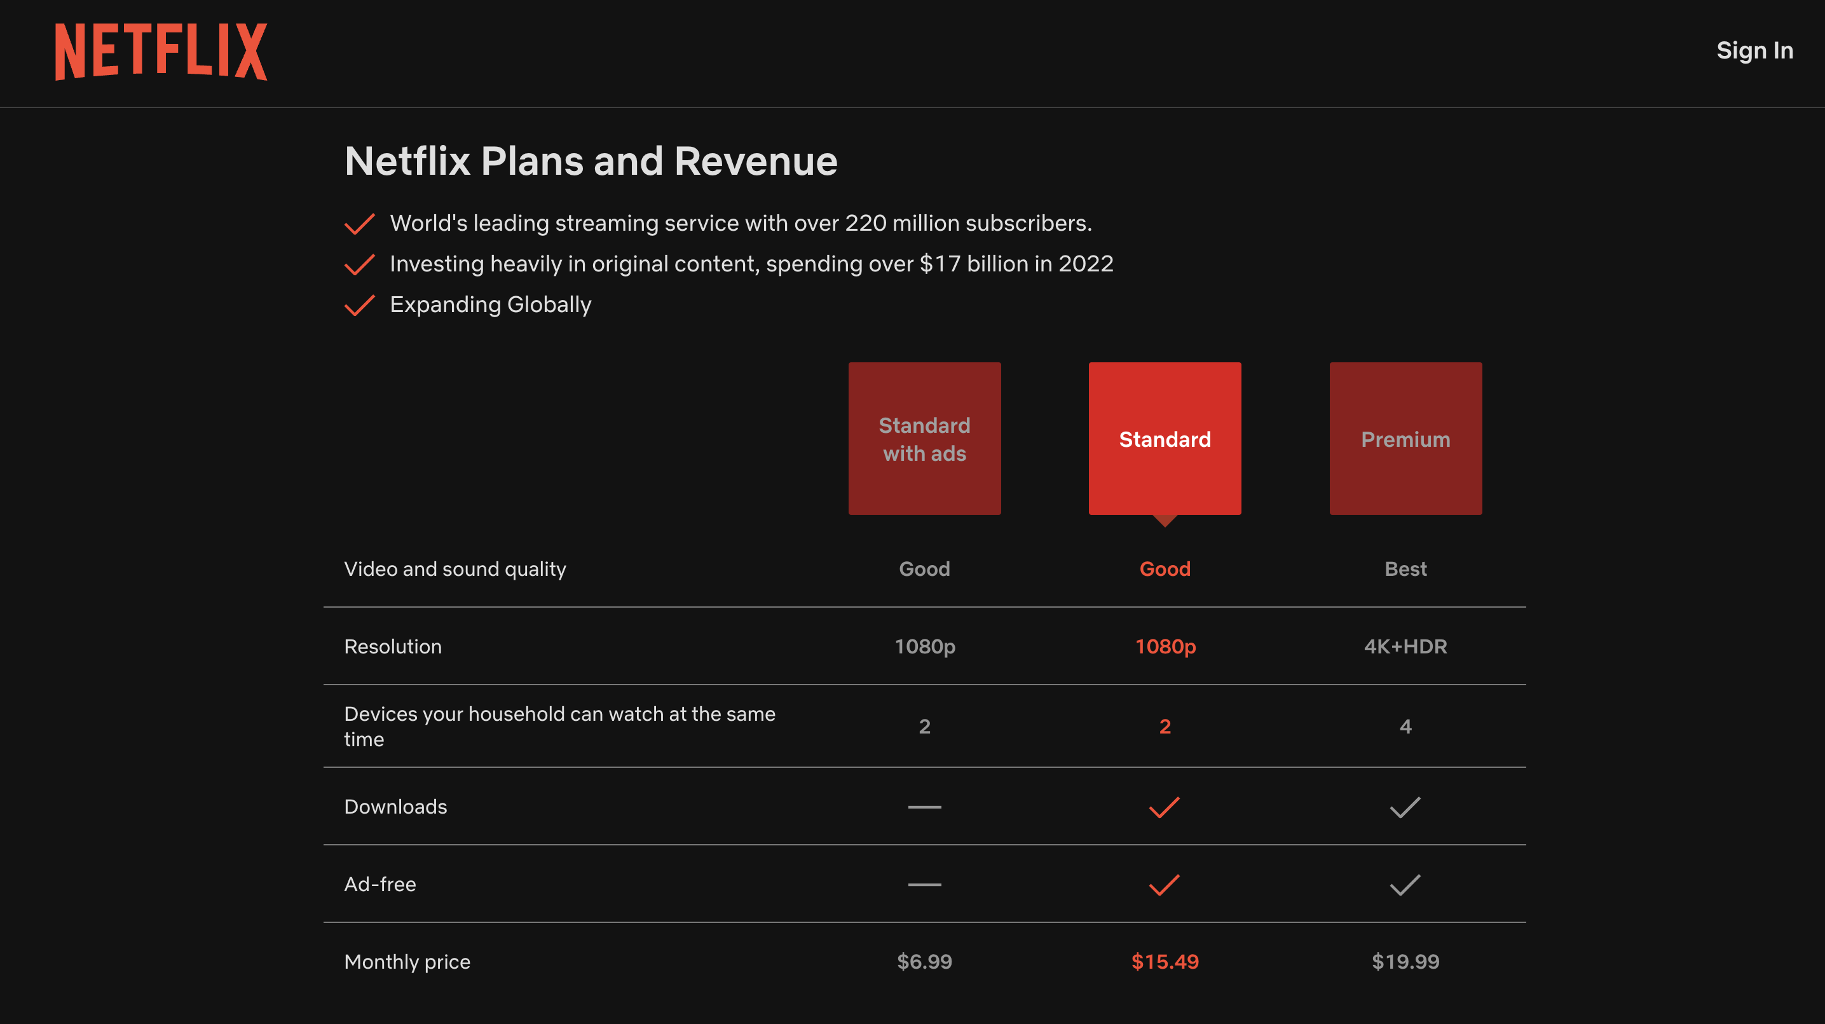
Play

Slide 15
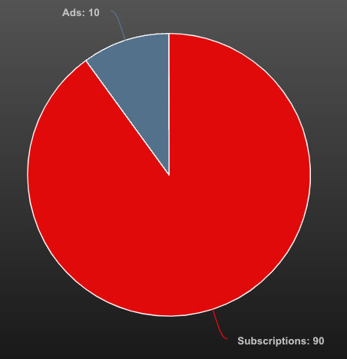
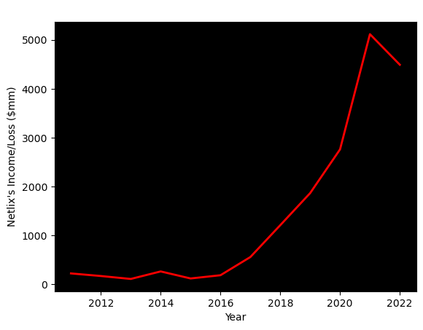
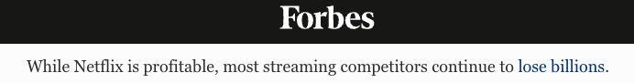
REVENUE
4
Revenue has grown steadily, reaching $31.6 billion in 2022
Profitable, generating over $4 billion in net income in 2022
Never reported a loss
Play
+

Slide 16
CRITICAL APPRECIATION
4
STRENGTHS
WEAKNESS
GROWTH AREAS
THREATS
User friendly
Data-driven insights
Adaptability
Brand Reputation
Global Presence
Subscription model pressure
Dependency on licensing agreements
Limited advertising revenue
Reinstate free trials
More Strategic Partnerships
Cross profile content suggestions
Capitalize on merchandise
Piracy and password sharing
OTT platform regulation from the government
Censorship of content
Rising competition from other streaming services
Play
+

Slide 17
REFERENCES
4
https://www.le-vpn.com/netflix-10-innovations-changed-world/
https://thestrategystory.com/blog/netflix-swot-analysis/
https://www.edrawmind.com/article/swot-analysis-of-netflix.html
https://www.perkupapp.com/post/10-competitive-netflix-employee-benefits-that-stand-out
https://jobs.netflix.com/work-life-philosophy
https://www.skillsire.com/read-blog/468_netflix-continues-to-dominate-how-netflix-kept-on-dominating-the-streaming-indus.html
https://www.businessinsider.com/how-netflix-is-changing-the-entertainment-industry-2021-8
https://www.comparitech.com/blog/vpn-privacy/netflix-statistics-facts-figures/#:~:text=Netflix%20offers%20content%20in%20over%2060%20languages
https://www.peppercontent.io/blog/netflix-app-features/
Play
+

Slide 18
thanks

